Slide 1
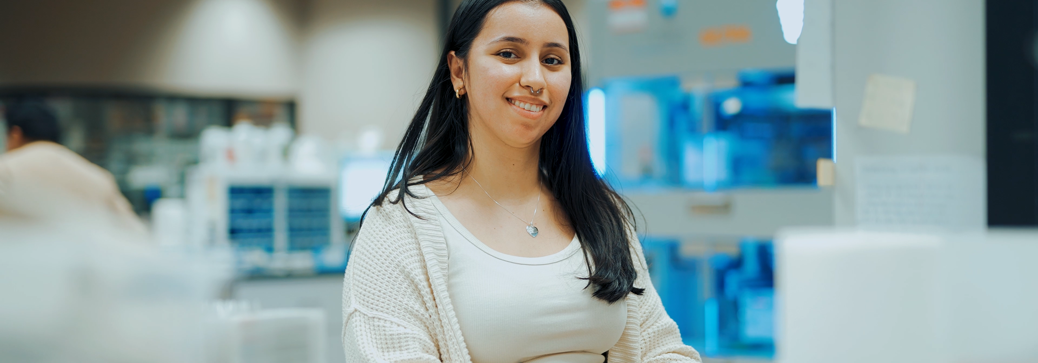
2025 Innovation Competition Showcase - Presentation
Scrumptious - Agile Ceremony Toolkit
Johnny Austin
12/8/2025
Notes:
Suggestion Time: 30 Seconds

Slide 2
AGENDA
05
06
07
08
Problem/Opportunity
The Solution
Proof of Concept/Demo
Business Case and Impact
01
02
03
04
Implementation & Resource Plan
Next Steps
Knowledge Share
Questions
Notes:
Suggestion Time: 30 Seconds

Slide 3
The Challenge
Our agile teams rely on fragmented tools for essential ceremonies—free Planning Poker sites with ads and limitations, and Parabol for retrospectives at $8/user/month ($4,700+/year). Scrum Masters spend time on setup and data compilation while teams switch between 3+ different platforms during sprint activities. With no integration between estimation and retrospective data, our historical ceremony insights remain trapped in separate systems, preventing meaningful pattern analysis and cross-ceremony insights that could improve sprint planning and team performance.
Beyond the cost savings, having fully customized tools tailored to our teams' workflows creates intangible value—boosting engagement, reducing friction, and fostering a culture of internal innovation.
Breadth of Impact: All 7 agile teams, ready to scale as SoftWriters adds teams
Current Impact: $4700+ savings per year going forward
Strategic Alignment: Supports SoftWriters' commitment to agile excellence, cost optimization, continuous improvement culture, and leveraging AI for internal efficiency gains
Fragmented Tools 🧩
High Costs 💰
Lost Insights 📊
Lacking Confidence ⚠️
Manual Setup Time ⏰
No Future Integrations 🔗
Notes:
Suggested time: 1 minute
The Challenge
Problem / Opportunity
Describe the problem you're solving or opportunity you're addressing:
What pain point exists today?
Breadth of Impact: Who is affected? (teams, departments, entire organization, industry?)
Current Impact: What is the quantifiable cost of this problem today?
Strategic Alignment: How does solving this align with our enterprise goals?

Slide 4
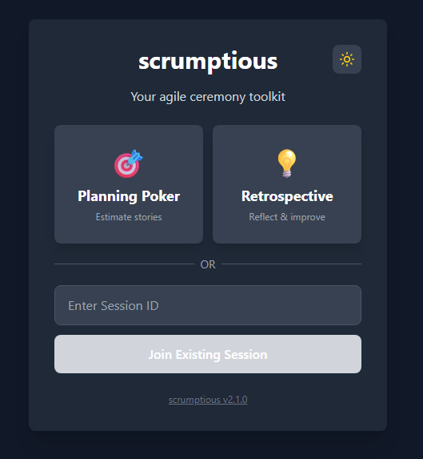
My Innovation
The Solution
Scrumptious is a custom-built, zero-friction agile ceremony toolkit that combines Planning Poker and Retrospectives into one seamless platform. Built with AI collaboration, it eliminates existing Parabol costs, removes external dependencies, and provides first of its kind features tailored to our teams' workflows.
Planning Poker
Retrospectives
Confidence-weighted voting (industry-first innovation)
Real-time consensus detection
Dual scales (Fibonacci & T-shirt sizing)
Automatic session history with editable estimates
Smart warnings for team uncertainty
Moderator, Participant and Observer functions
4 format options (Start/Stop/Continue, Glad/Sad/Mad, Went Well/To Improve, Original 4)
3-phase workflow: Input → Grouping → Discussion
Anonymous input with collaborative grouping
Emoji reactions for sentiment tracking
Excel exports with enhanced formatting
Notes:
Suggested time: 1 Minute
The wow factor! – key judging criteria
Our Innovation
The Solution
Explain your innovative solution:
What is your solution? (high-level overview)
How does it work technically?
What makes it innovative compared to current approaches?
Organizational Fit: How does this align with our strategic priorities and capabilities?

Slide 5
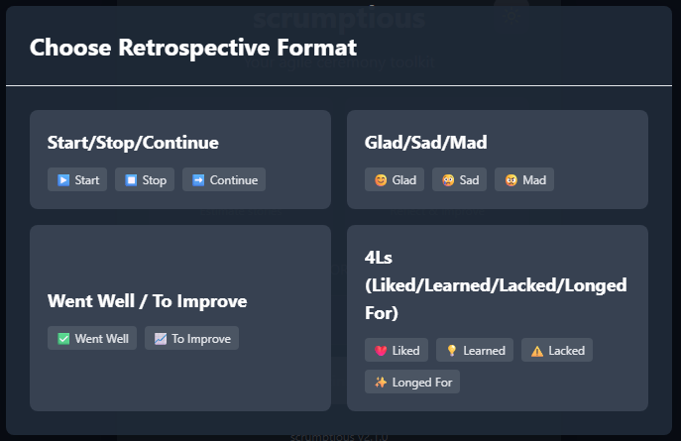
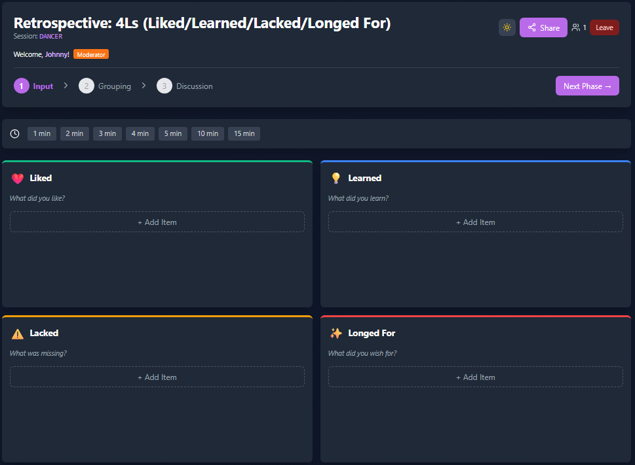
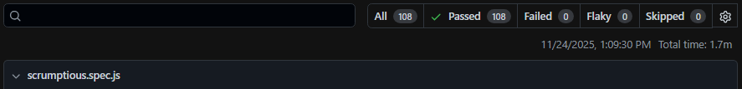
Proof of Concept & Demo
https://johnnys-scrumptious-app.vercel.app/
108 Passing Playwright Automated Tests
Notes:
Suggested Time: 2 Minutes (including Demo)
Demonstration
Proof of Concept & Demo (whatever is applicable)
Show your working prototype:
Live demo, screenshots, or video demonstration
Key features and functionalities demonstrated
Current development stage and testing results

Slide 6
Business Case & Impact
$4700+ yearly cost savings
Fewer re-estimations
Two tools in one | Confidence voting | Cross-ceremony analytics | No ads | Full control
Notes:
Same as Slide 6 – Use if want different chart

Slide 7
Implementation & Resource Plan
Scalability & Improvements
A resounding YES! Already in action with all seven development teams.
Report A Bug/Feature Request works well for continuous improvements
Automation: Self-service session creation, automated CI/CD deployment, real-time Firebase sync
Accuracy: 25% reduction in re-estimation, confidence-weighted voting insights
Scalability: Enterprise-ready - scales from 47 to 200+ users with no code changes, Firebase handles 100K+ connections
Feasibility: Will It Work?
Development - Oct 2025 ✓
Rollout - Nov 2025 ✓
Complete Beta – Dec 2025
Cancel Parabol -Q1 2026
Budget Required: $0 development (already complete) Resources: Low time effort for maintenance as needed
Timeline: Basically Complete
Dependencies: Firebase/Vercel hosting (free and scalable within our needs)
Budget & Resources
Extras
Notes:
Suggested time: 1 minute
Feasibility & Scalability - KEY JUDGING CRITERIA
Implementation & Resource Plan
Feasibility: Will It Work?
Demonstrate: Technical viability, organizational fit, and alignment with our strategic direction
Scalability & Improvements
Automation: What processes get automated?
Accuracy: % improvement in quality/precision
Beyond Pilot: Path from pilot to full deployment
Scalability: Can this grow org-wide or industry-wide?
Budget & Resources
Budget Required: $X for development, implementation
Team Size: FTEs needed
Timeline: Pilot → Scale → Full rollout
Dependencies: Technology, approvals, etc.

Slide 8
Moving Forward - Immediate Next Steps
✓ Roll out to all development teams ✓
Completed November 2025
Continue utilizing during December Checking for bugs or user-suggested improvements
Cancel Parabol subscription
Notes:
Suggested time: 1 minute
Moving Forward
Next Steps
Immediate Next Steps
Action 1
Action 2
Action 3
Support Needed
[What resources, approvals, or support do you need to move forward?]

Slide 9
Knowledge Share
AI Pair Programming Works at Scale Non-developers can build production tools with AI. Domain knowledge + clear requirements = functional software.
Remove Friction, Not Add Features QR codes, memorable IDs, and single-platform access drove quick adoption. Reducing setup from 5 min to <1 min has had massive impact.
Automated Testing is Essential 108 tests with CI/CD accelerated development and enabled confident deployments. "Know it works" vs. "hope it works."
Solve Your Own Problems Building what I use daily ensured quality and relevance. Subject matter experts + AI = working solutions
Notes:
Knowledge Share from going through the showcase –
Time suggestion: 30 seconds to 1 minute
Learning 1
Learning 2
Learning 3

Slide 10
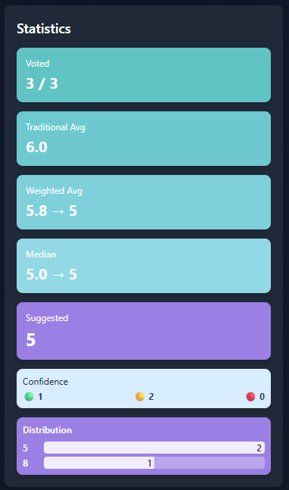
Questions?

